Slide 1
Data Mining: Anomaly Detection
Tom Heskes

Slide 2
Anomaly/Outlier Detection
What are anomalies/outliers?
The set of data points that are considerably different from the remainder of the data
Variants of Anomaly/Outlier Detection Problems
Given a database D, find all the data points x ∈ D with anomaly scores greater than some threshold t
Given a database D, find all the data points x ∈ D having the top-n largest anomaly scores f(x)
Given a database D, containing mostly normal (but unlabeled) data points, and a test point x, compute the anomaly score of x with respect to D
Applications:
Credit card fraud detection, telecommunication fraud detection, network intrusion detection, fault detection

Slide 3
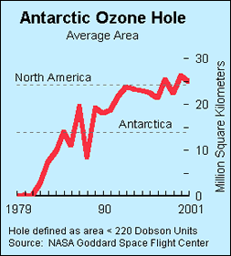
Importance of Anomaly Detection
In 1985 three researchers (Farman, Gardinar, and Shanklin) were puzzled by data gathered by the British Antarctic Survey showing that ozone levels for Antarctica had dropped 10% below normal levels
Why did the Nimbus 7 satellite, which had instruments aboard for recording ozone levels, not record similarly low ozone concentrations?
The ozone concentrations recorded by the satellite were so low they were being treated as outliers by a computer program and discarded!

Slide 4
Anomaly Detection
Challenges
How many outliers are there in the data?
Method is unsupervised, so validation can be quite challenging (just like for clustering)
Finding needle in a haystack
Working assumption:
There are considerably more “normal” observations than “abnormal” observations (outliers/anomalies) in the data

Slide 5
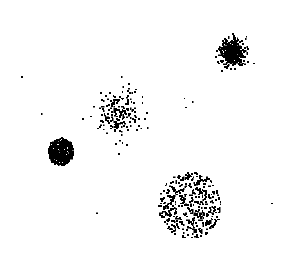
Anomaly Detection Schemes
General Steps
Build a profile of the “normal” behavior, e.g., patterns or summary statistics for the overall population
Use the “normal” profile to detect anomalies: Anomalies are observations whose characteristics differ significantly from the normal profile
Types of anomaly detection schemes
Graphical & statistical-based
Distance-based
Model-based

Slide 6
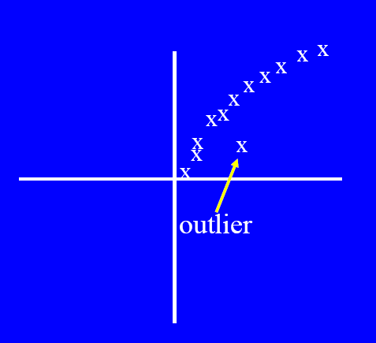
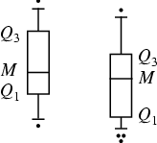
Graphical Approaches
Boxplot (1-D), Scatter plot (2-D), Spin plot (3-D)
Limitations
Time consuming
Subjective

Slide 7
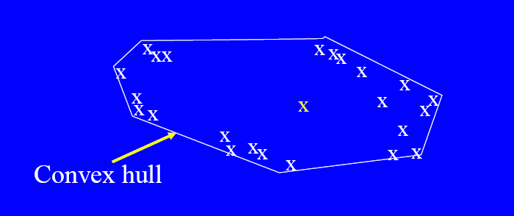
Convex Hull Method
Extreme points are assumed to be outliers
Use convex hull method to detect extreme values
What if the outlier occurs in the middle of the data?

Slide 8
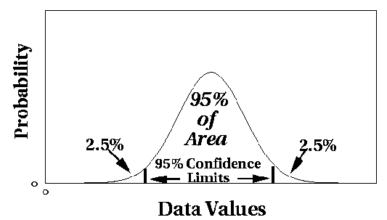
Statistical Approaches
Assume a parametric model describing the distribution of the data (e.g., normal distribution)
Apply a statistical test that depends on
Data distribution
Parameter of distribution (e.g., mean, variance)
Number of expected outliers (confidence limit)

Slide 9
Grubb’s Test
Detect outliers in univariate data
Assume data comes from normal distribution
Detects one outlier at a time, remove the outlier, and repeat
H₀: There is no outlier in data
H_{A}: There is at least one outlier
Grubbs’ test statistic:
Reject H₀ if:

Slide 10
Limitations of Statistical Approaches
Most of the tests are for a single attribute
In many cases, data distribution may not be known
For high dimensional data, it may be difficult to estimate the true distribution

Slide 11
Distance-Based Approaches
Data is represented as a vector of features
Three major approaches
Nearest-neighbor based
Density based
Clustering based

Slide 12
Nearest-Neighbor Based Approach
Compute the distance between every pair of data points
There are various ways to define outliers:
Data points for which there are fewer than p neighboring points within a distance D
The top n data points whose distance to the kth nearest neighbor is greatest
The top n data points whose average distance to the k nearest neighbors is greatest

Slide 13
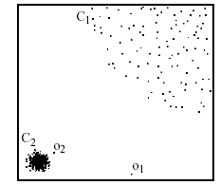
Density-Based: Local Outlier Factor
For each point, compute the density of its local neighborhood
Compute local outlier factor (LOF) of a sample p as the average of the ratios of the density of sample p and the density of its nearest neighbors
Outliers are points with largest LOF value
In the NN approach, p₂ is not considered as outlier, while the LOF approach finds both p₁ and p₂ as outliers
p₂
×
p₁
×

Slide 14

Clustering-Based
Cluster the data into groups of different density
Choose points in small cluster as candidate outliers
Compute the distance between candidate points and non-candidate clusters: if these candidate points are far from all other non-candidate points, they are outliers

